Slide 1


Texas Community Development Block Grant Program
TDA-GO Financial Management Tools
(Fund Source Calculator & Disbursement of Funds)
Notes:
Hello, welcome to another edition of CDBG Over Coffee. This presentation will cover the new financial management tools added to TDA-GO. Those tools are the Fund Source Calculator and Disbursement of Funds. At the end of the presentation there will be time for Q & A. Okay let's get started!

Slide 2

What is the TDA-GO Fund Source Calculator?
The TDA-GO Fund Source Calculator on TDA-GO replaces the A208 – TxCDBG Match Calculator form. The calculator assists with calculating an agreements overall expenditures including grant funds, match, additional local funds, other eligible and ineligible costs.
Grantees and administrators should at a minimum review the information in the Fund Source Calculator:
after the information for the construction MSR has been entered into TDA-GO,
90 days before the grant agreement end date, and
prior to submitting the MSR Completion Report, final Payment Request and Project Completion Report.
Notes:
What is the TDA-GO Fund Source Calculator?
The TDA-GO Fund Source Calculator replaces the A208 – TxCDBG Match Calculator form. The calculator assists with calculating an agreements overall expenditures including grant funds, match, additional local funds, other eligible and ineligible costs.
Grantees and administrators should at a minimum review the information in the Fund Source Calculator:
after the information for the construction MSR has been entered into TDA-GO,
90 days before the grant agreement end date, and
prior to submitting the MSR Completion Report, final payment request and Project Completion Report.

Slide 3
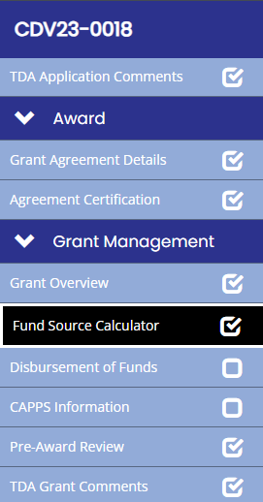
Where is the TDA-GO Fund Source Calculator located?
Notes:
Where is the TDA-GO Fund Source Calculator located?
On the left navigation menu scroll down to the Grant Management section and then click on Fund Source Calculator tab. In addition, please note that Disbursement of Funds tab is also located in this section.

Slide 4
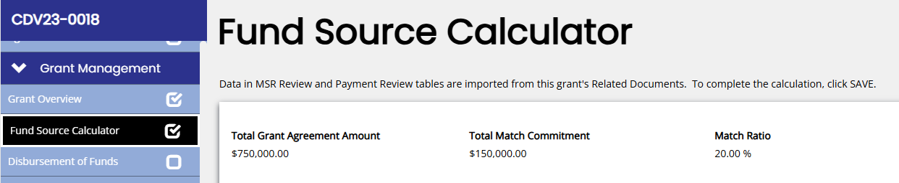
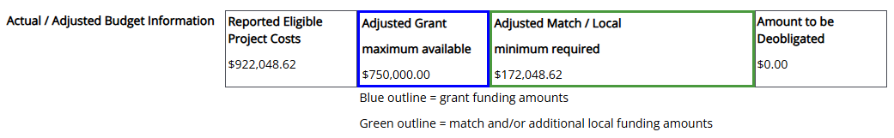
Agreement Amounts
Notes:
The top of the page will reflect the total grant agreement amount, total match commitment and match ratio. The match ratio is calculated by diving the total match funds amount reflected on the MSRs by the total grant funds amount.
When a project is underbudget, the grant and match budgets are both reduced proportionally to share in the cost savings and maintain the match ratio from the grant agreement. This calculator will help you ensure you are both meeting the commitment to matching funds and claiming the maximum amount available for reimbursement.
There are three sections on the calculator that are color coded to match. When you see a field outlined in blue, this indicates total grant funding and corresponds to all other fields outlined in blue. Likewise, match funding information is outlined in green.

Slide 5
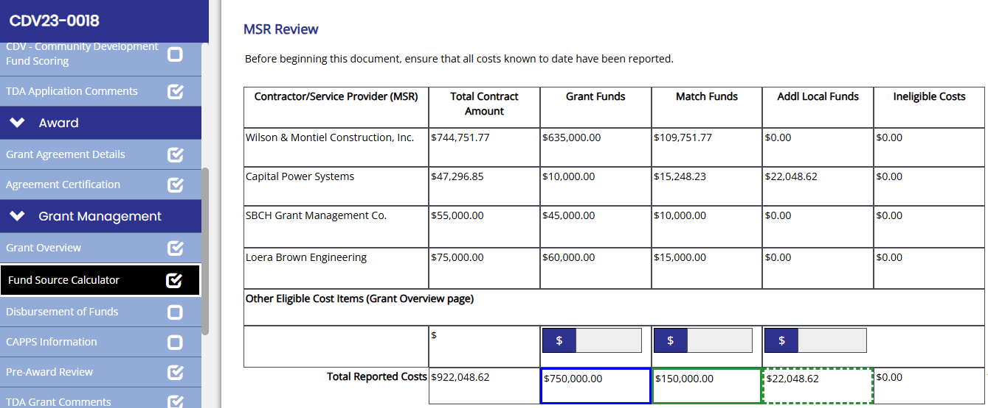
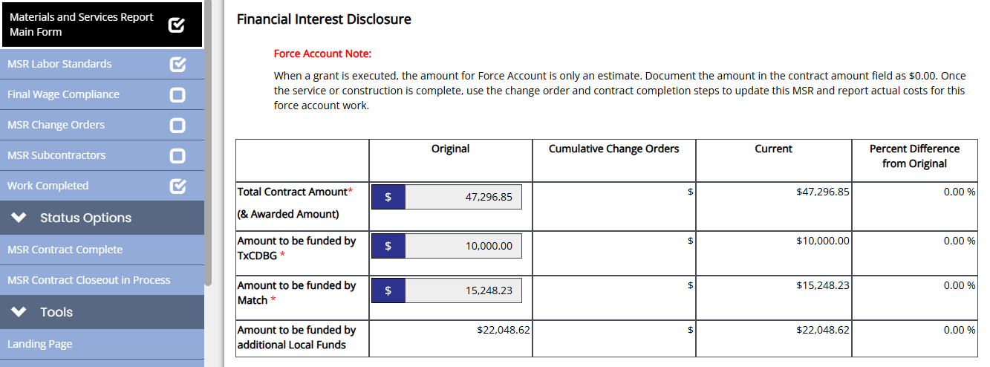
MSR Review
Notes:
The MSR Review section reflects the information reported to date on the Materials and Services Reports (MSRs) and the Grant Overview page (Other Eligible Costs).
The Total Contract Amount Column will reflect the amount for each MSR including grant, match and additional local funds.
For example, the contract total amount for Contractor/Service Provider Capital Power Systems includes $10,000 in grant funds, $15,248.23 in match funds and $22,048.62 in additional local funds for a total contract amount of $47,296.85
The information entered, submitted and approved in an MSR is the information that will reflect on the MSR Review section of the Calculator. Therefore, you can only update the calculator by revising the information reported in the MSR.

Slide 6
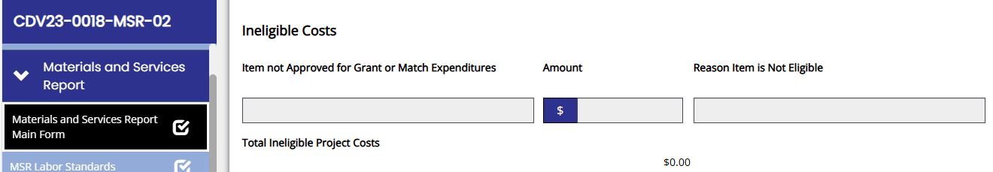
MSR Review - Ineligible Costs
Notes:
Ineligible costs reflected on an MSR will be displayed on the MSR Review section of the Fund Source Calculator, and will not count toward the calculation. In this example there were no ineligible costs.

Slide 7
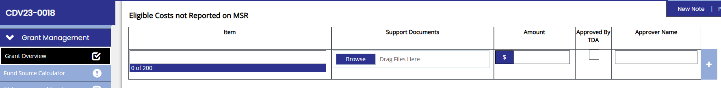
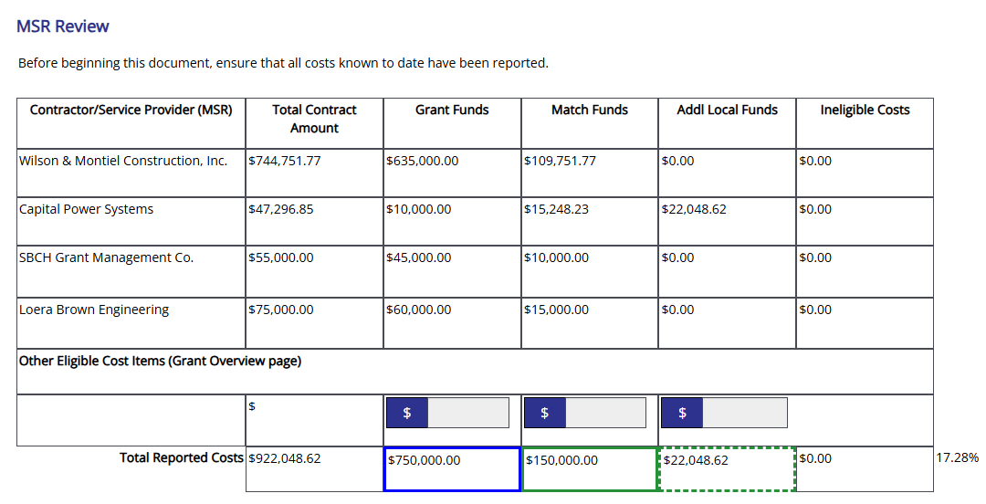
MSR Review - Other Eligible Costs
Notes:
Other Eligible Costs
In this example, there were no other eligible costs reported.
Other Eligible Costs should be reported under the Grant Management section in the Grant Over tab in the Eligible Costs Not Reported on the MSR section. Administrators should send their assigned Grant Specialist an email when this documentation is uploaded as uploads to this section do not generate a TDA-GO notification.
The information entered here for Other Eligible Costs will be reflected on the MSR Review section of the Fund Source Calculator in the reflected field circled in orange. The administrator will enter the amount of the Other Eligible Costs reported into the appropriate fund category field or fields in the MSR Review section.
Some examples of Other Eligible Costs are:
A micro purchase under $2,000
Acquisition payment(s) for grant or match
Publications
Certified Mail
Connection fees (match for credit for waving connection fee for Non-LMI)

Slide 8
MSR Review
Notes:
Once all project costs have been entered on the MSR or Grant Overview page, compare the MSRs Review section’s Total Reported Costs to the Actual / Adjusted Budget Information.
The Actual Adjusted Budget takes the total eligible costs you’ve reported and prorates those costs between grant funding and match funding (or local funds in addition to the committed matching funds).
Compare the fields outlined in blue – in this example, the Calculator has determined that $750,000 is the maximum grant amount available, and the MSR Review shows $750,000 assigned to grant funding. The green fields also show accurate costs assignment to meet the match commitment. Therefore, no revisions are needed to the MSRs or Grant Overview costs for this grant.
If the total eligible project costs is less than the total original budget including grant and match, the project is under budget, and grant funds available will appear in the amount to be deobligated field. In this example there are no grant funds to be deobligated.

Slide 9
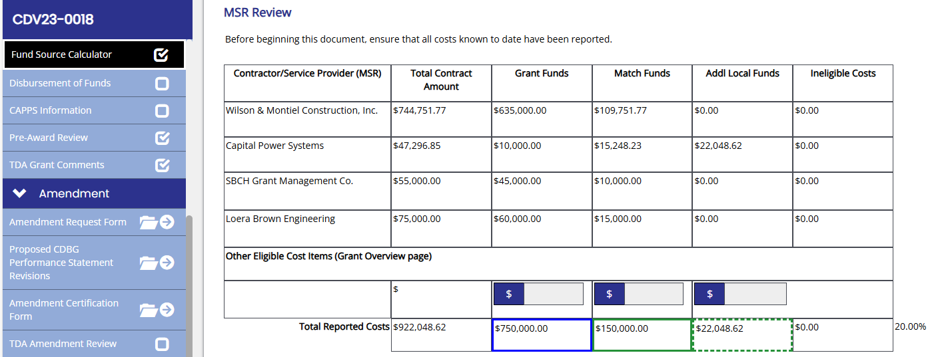
MSR Review – Match Ratio
Notes:
The current match ratio is reflected on lower right corner of the MSR Review section and is another indicator of whether an MSR revision is needed to reallocate funds between grant and match.
At the end of the agreement if the current match ratio for Reported Costs is:
Below the committed match ratio the grantee has not accounted for enough match and should review MSRs and Grant Overview costs. Are there additional costs not yet reported? Should costs be shifted from grant to matching funds?
Or if the current match ratio is
Over the committed match ratio the grantee should confirm they have maximized the use of grant funds. If the calculator indicates funds will be deobligated while the match ratio is exceeded, shift costs from matching funds to use the grant funds that are still available.

Slide 10
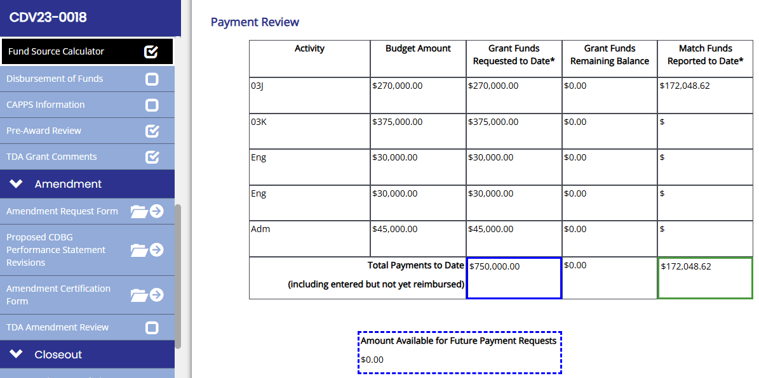
Payment Review
Notes:
The Payment Review section reflects all payment requests that have been entered, including any payment request that is In Process status and not yet submitted.
In this example all payment requests (including the final payment for administrative services) have been submitted. Once again, the amounts in the highlighted blue fields should match for grant funding. The amounts in the green outlined fields should also match – noting that the Payments may not have reported any additional local funds. The amount reflected in the Amount Available for Future Payment Requests field is the amount a grantee can still request for payment based on all payment requests submitted and the Actual / Adjusted Budget information.

Slide 11
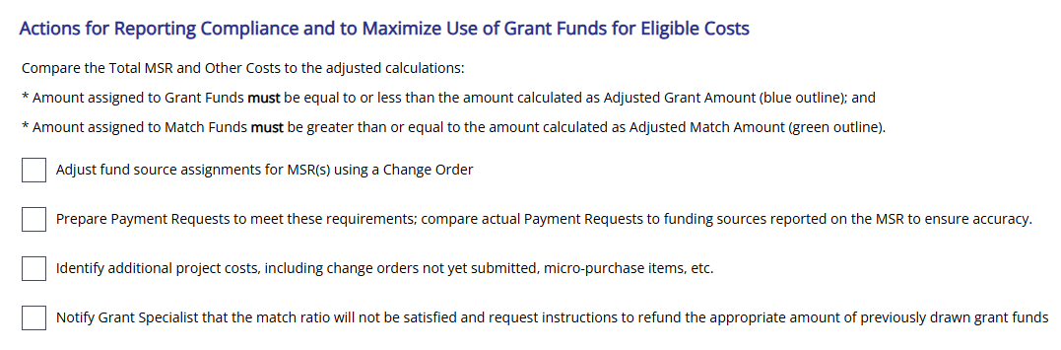
Maximizing the Use of Grant Funds
This tool will assist grantees in maximizing the use of grant funds.
Notes:
Maximizing the Use of Grant Funds
This tool is intended to assist grantees in maximizing the use of grant funds.
The following suggestions will assist grantees accomplishing this goal:
Adjusting fund source assignments for MSRs via a Change Order
Comparing actual payment requests to funding sources reported on MSRs for accuracy
Identifying additional project costs, including change orders not yet submitted, micro-purchase items, etc.
Notifying the grant specialist that the match ratio will not be satisfied and request instructions to refund the appropriate amount of previously drawn grant funds

Slide 12
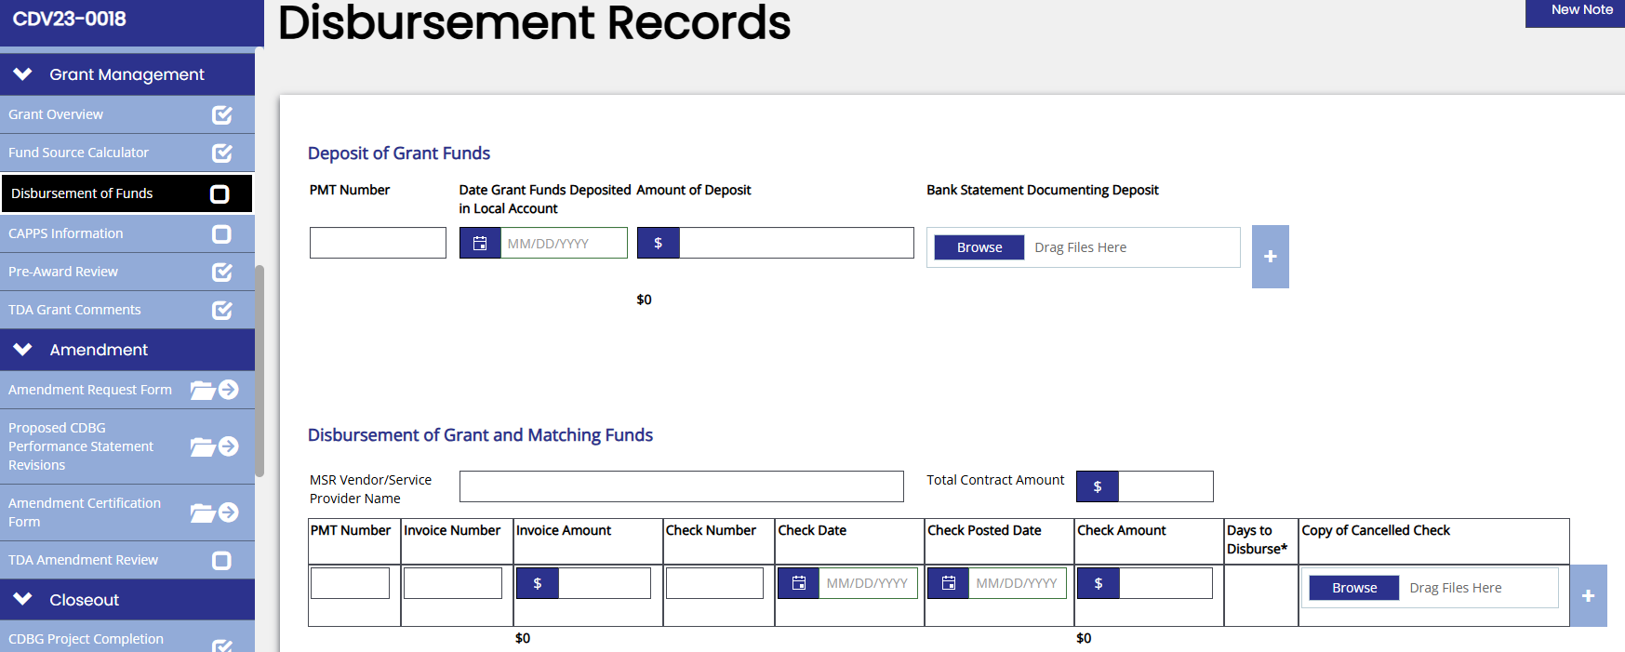
Disbursement of Funds
Notes:
Disbursement of Funds reporting throughout the grant agreement period became effective January 1, 2026. Disbursement documentation for a previous payment request will be required to be uploaded to the Disbursement of Funds tab before a subsequent payment request is submitted.
This includes documentation of:
Deposit of grant funds (bank statement documenting deposit)
Disbursement of grant and match funds (copies of cancelled checks)

Slide 13
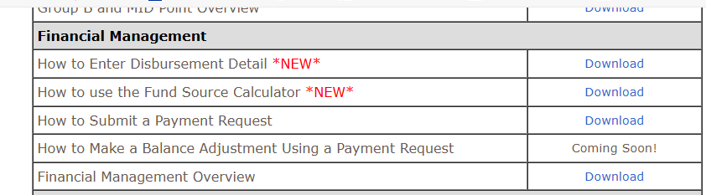
Disbursement of Funds
Became effective January 1, 2026.
Upload Documentation
March 1, 2026
Notes:
Beginning March 1, 2026, any payment request submitted that has not yet uploaded the disbursement documentation from the previous payment request will be placed on HOLD. The “How to” guide on uploading disbursement documentation can be found on the TDA website. In addition, the “How to” guide on using the Fund Source Calculator is also located here.

Slide 14

Questions/Comments
Notes:
Thank you for your attention. We will now open the presentation for Q & A.

